Slide 1
SOLID Design Principles
Instructor: Mehroze Khan

Slide 2
SOLID Principles
Good software systems begin with clean code
The SOLID principles tell us how to arrange our functions and data structures into classes, and how those classes should be interconnected
The goal of the principles is the creation of mid-level software structures that:
Tolerate change
Are easy to understand
Are the basis of components that can be used in many software systems
The term “mid-level” refers to the fact that these principles are applied by programmers working at the module level.

Slide 3
SOLID Principles
SRP: The Single Responsibility Principle
OCP: The Open-Closed Principle
LSP: The Liskov Substitution Principle
ISP: The Interface Segregation Principle
DIP: The Dependency Inversion Principle

Slide 4
LSP-Liskov Substitution Principle
The Liskov Substitution Principle states that subclasses should be substitutable for their base classes.
This means that, given that class B is a subclass of class A, we should be able to pass an object of class B to any method that expects an object of class A and the method should not give any weird output in that case.
This is the expected behavior, because when we use inheritance, we assume that the child class inherits everything that the superclass has. The child class extends the behavior but never narrows it down.
Therefore, when a class does not obey this principle, it leads to some bugs that are hard to detect.

Slide 5
Example (Bird)
public class Bird { public void eat() { System.out.println("I can eat."); } public void fly() { System.out.println("I can fly."); }
}

Slide 6
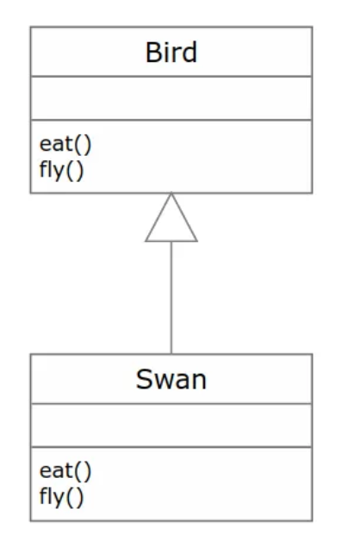
Example (Bird)
public class Swan extends Bird { @Override public void eat() { System.out.println("OMG! I can eat pizza!"); } @Override public void fly() { System.out.println("I believe I can fly!"); } }

Slide 7
Example (Bird)
public class Main { public static void letBirdsFly(List<Bird> birds) { for(Bird bird: birds) { bird.fly(); } } public static void main(String[] args) { List<Bird> birds = new ArrayList<Bird>(); birds.add(new Bird()); letBirdsFly(birds); } }

Slide 8
Example (Bird)
Main is the main class of our program which contains its logic.
It has two methods, letBirdsFly(List<Bird> birds) and main(String[] args).
The first method takes a list of birds as a parameter and invokes their fly methods.
The second one creates the list and passes it to the first.
We are going to replace the Bird object with the Swan object.

Slide 9
Example (Bird)
public static void main(String[] args) { List<Bird> birds = new ArrayList<Bird>(); birds.add(new Swan()); letBirdsFly(birds); }
If we try to run the program after applying the changes, it will output the following statement: I believe I can fly!
We can see that the principle applies to our code perfectly. The program works as expected without any errors or problems. But what if we add another class of Penguin?

Slide 10
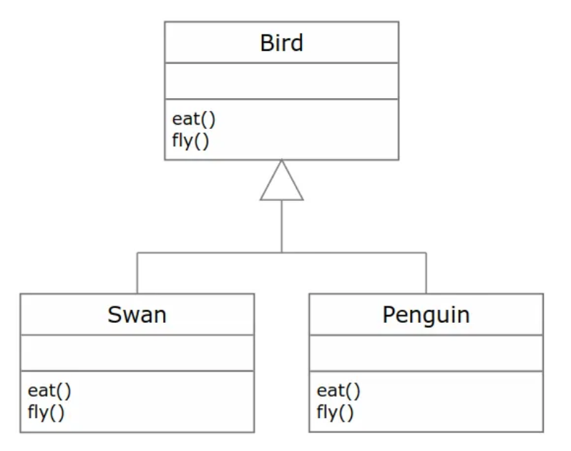
Example (Bird)
public class Penguin extends Bird {
@Override
public void eat() {
System.out.println("Can I eat taco?");
}
@Override
public void fly() {
throw new UnsupportedOperationException("Help! I cannot fly!");
}
}

Slide 11
Example (Bird)
public static void main(String[] args) {
List<Bird> birds = new ArrayList<Bird>();
birds.add(new Swan());
birds.add(new Penguin());
letBirdsFly(birds);
}
// I believe I can fly!
//Exception in thread "main" java.lang.UnsupportedOperationException: Help! I cannot fly!

Slide 12
Example (Bird)
We can see that with the Swan object, the code worked perfectly.
But with the Penguin object, the code threw UnsupportedOperationException.
This violates the Liskov Substitution Principle as the Bird class has a child that didn't use inheritance correctly, hence caused a problem.
The Penguin tries to extend the flying logic, but it can't fly!

Slide 13
Example (Bird) Fix
public static void letBirdsFly(List<Bird> birds) { for(Bird bird: birds) { if(!(bird instanceof Penguin)) { bird.fly(); } } }
But this solution is considered a bad practice, and it violates the Open-Closed Principle.
Imagine if we add another three types of birds that cannot fly. The code is going to become a mess.

Slide 14
Example (Bird) Fix
public class Bird {
public void eat() {
System.out.println("I can eat.");
}
}
public class FlyingBird extends Bird {
public void fly() {
System.out.println("I can fly.");
}
}
public class Swan extends FlyingBird {
@Override
public void eat() {
System.out.println("OMG! I can eat pizza!");
}
@Override
public void fly() {
System.out.println("I believe I can fly!");
}
}
public class Penguin extends Bird {
@Override
void eat() {
System.out.println("Can I eat taco?");
}
}

Slide 15
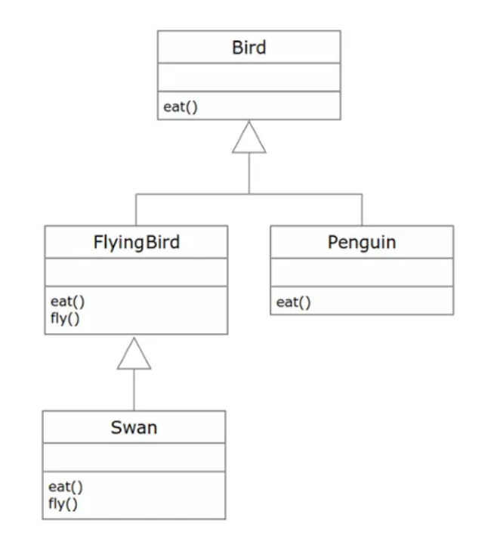
Example (Bird) Solution

Slide 16
Example (Bird) Solution
public class Main {
public static void letBirdsFly(List<FlyingBird> flyingBirds) {
for(FlyingBird flyingBird: flyingBirds) {
flyingBird.fly();
}
}
public static void main(String[] args) {
List<FlyingBird> flyingBirds = new ArrayList<FlyingBird>();
flyingBirds.add(new Swan());
letBirdsFly(flyingBirds);
}
}

Slide 17
class Rectangle {
protected int width, height;
public Rectangle() {
}
public Rectangle(int width, int height) {
this.width = width;
this.height = height;
}
public int getWidth() {
return width;
}
public void setWidth(int width) {
this.width = width;
}
public int getHeight() {
return height;
}
public void setHeight(int height) {
this.height = height;
}
public int getArea() {
return width * height;
}
}

Slide 18
Now we decide to create another class for Squares.
As you might know, a square is just a special type of rectangle where the width is equal to the height.

Slide 19
class Square extends Rectangle {
public Square() {}
public Square(int size) {
width = height = size;
}
@Override
public void setWidth(int width) {
super.setWidth(width);
super.setHeight(width);
}
@Override
public void setHeight(int height) {
super.setHeight(height);
super.setWidth(height);
}
}

Slide 20
Violation
Our Square class extends the Rectangle class. We set height and width to the same value in the constructor, but we do not want any client (someone who uses our class in their code) to change height or weight in a way that can violate the square property.
Therefore, we override the setters to set both properties whenever one of them is changed. But by doing that we have just violated the Liskov substitution principle.

Slide 21
class Test {
static void getAreaTest(Rectangle r) {
int width = r.getWidth();
r.setHeight(10);
System.out.println("Expected area of " + (width * 10) + ", got " + r.getArea());
}
public static void main(String[] args) {
Rectangle rc = new Rectangle(2, 3);
getAreaTest(rc);
Rectangle sq = new Square();
sq.setWidth(5);
getAreaTest(sq);
}
}

Slide 22
Your team's tester just came up with the testing function getAreaTest and tells you that your getArea function fails to pass the test for square objects.
In the first test, we create a rectangle where the width is 2 and the height is 3 and call getAreaTest. The output is 20 as expected, but things go wrong when we pass in the square.
This is because the call to setHeight function in the test is setting the width as well and results in an unexpected output.

Slide 23
ISP-Interface Segregation Principle
Segregation means keeping things separated, and the Interface Segregation Principle is about separating the interfaces.
The principle states that many client-specific interfaces are better than one general-purpose interface.
Clients should not be forced to implement a function they do not need.

Slide 24
public interface ParkingLot {
void parkCar(); // Decrease empty spot count by 1
void unparkCar(); // Increase empty spots by 1
void getCapacity(); // Returns car capacity
double calculateFee(Car car); // Returns the price based on number of hours
void doPayment(Car car);
}
class Car {
}

Slide 25
We modeled a very simplified parking lot. It is the type of parking lot where you pay an hourly fee.
Now consider that we want to implement a parking lot that is free.

Slide 26
public class FreeParking implements ParkingLot {
@Override
public void parkCar() {
}
@Override
public void unparkCar() {
}
@Override
public void getCapacity() {
}
@Override
public double calculateFee(Car car) {
return 0;
}
@Override
public void doPayment(Car car) {
throw new Exception("Parking lot is free");
}
}

Slide 27
Our parking lot interface was composed of 2 things: Parking related logic (park car, unpark car, get capacity) and payment related logic.
But it is too specific. Because of that, our FreeParking class was forced to implement payment-related methods that are irrelevant. Let's separate or segregate the interfaces.

Slide 28
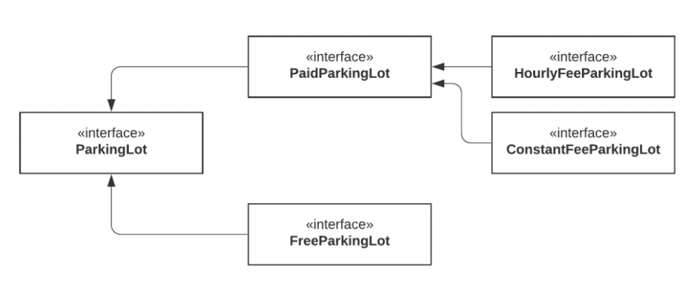
We've now separated the parking lot. With this new model, we can even go further and split the PaidParkingLot to support different types of payment.
Now our model is much more flexible, extendable, and the clients do not need to implement any irrelevant logic because we provide only parking-related functionality in the parking lot interface.

Slide 29
Example
Let’s assume that there is a Restaurant interface which contains methods for accepting orders from online customers, telephone customers and walk-in customers.
It also contains methods for handling online payments (for online customers) and in-person payments.
In-person payments deal with the walk-in customers as well as telephone customers.
Moreover, telephone customers pay in-person at the time of order delivery.

Slide 30
public interface RestaurantInterface {
public void acceptOnlineOrder();
public void acceptTelephoneOrder();
public void acceptWalkInCustomerOrder();
public void payOnline();
public void payInPerson();
}

Slide 31
public class OnlineCustomerImpl implements RestaurantInterface {
public void acceptOnlineOrder() {
//logic for placing online order
}
public void acceptTelephoneOrder() {
//Not Applicable for Online Order
throw new UnsupportedOperationException();
}
public void payOnline() {
//logic for paying online
}
public void acceptWalkInCustomerOrder() {
//Not Applicable for Online Order
throw new UnsupportedOperationException();
}
public void payInPerson() {
//Not Applicable for Online Order
throw new UnsupportedOperationException();
}
}

Slide 32
Since OnlineCustomerImpl is for online customers, we will have to throw UnsupportedOperationException for the methods which are not applicable for online customers.
This is also termed as ‘Interface Pollution’. Here we can observe clear violation of Interface Segregation Principle.

Slide 33
How to Fix?
Separate out payment and order placement functionalities into two separate lean interfaces, PaymentInterface and OrderInterface.
public interface OrderInterface{
public void placeOrder();
}
public interface PaymentInterface{
public void payForOrder();
}

Slide 34
How to Fix?
public class OnlineCustomerImpl implements OrderInterface, PaymentInterface {
@Override
public void placeOrder() {
// logic to place online order
}
@Override
public void payForOrder() {
// logic to do online payment
}
}

Slide 35
How to Fix?
public class WalkInCustomerImpl implements OrderInterface, PaymentInterface {
@Override
public void placeOrder() {
// logic to place in-person order
}
@Override
public void payForOrder() {
// logic to do in-person payment
}
}

Slide 36
Another Example
public interface IWorker
{
void Work();
void Eat();
void Sleep();
}
Now, imagine we have two classes, HumanWorker and RobotWorker that implement this interface

Slide 37
Another Example
public class HumanWorker : IWorker
{
public void Work() { /*...*/ }
public void Eat() { /*...*/ }
public void Sleep() { /*...*/ }
}
public class RobotWorker : IWorker
{
public void Work() { /*...*/ }
public void Eat() { /*...*/ } // Not applicable to robots
public void Sleep() { /*...*/ } // Not applicable to robots
}

Slide 38
In this example, the IWorker interface violates the ISP, as it forces the RobotWorker class to implement the Eat and Sleep methods, which are irrelevant for robots.
To adhere to the ISP, we can break down the IWorker interface into smaller, more specific interfaces

Slide 39
How to Fix?
public interface IWorkable
{
void Work();
}
public interface IEatable
{
void Eat();
}
public interface ISleepable
{
void Sleep();
}

Slide 40
How to Fix?
public class HumanWorker : IWorkable, IEatable, ISleepable
{
public void Work() { /*...*/ }
public void Eat() { /*...*/ }
public void Sleep() { /*...*/ }
}
public class RobotWorker : IWorkable
{
public void Work() { /*...*/ }
}

Slide 41
DIP-Dependency Inversion Principle
The Dependency Inversion principle states that our classes should depend upon interfaces or abstract classes instead of concrete classes and functions.
We want our classes to be open to extension, so we have reorganized our dependencies to depend on interfaces instead of concrete classes.
DIP tells us that every dependency in the design should target an interface or an abstract class. Furthermore, a dependency should not target a concrete class.

Slide 42
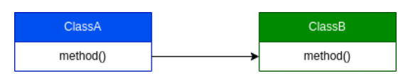
Example
Suppose ClassA depends on ClassB. At runtime, an instance of ClassB will be created or injected into ClassA.
class ClassB {
// fields, constructor and methods
}
class ClassA {
ClassB objectB;
ClassA(ClassB objectB) {
this.objectB = objectB;
}
// invoke classB methods
}

Slide 43
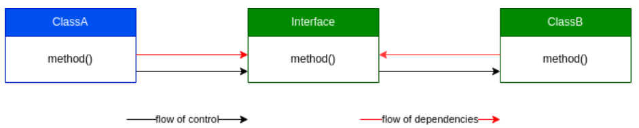
Example
DIP is telling us is to invert the dependency.
The flow of control will still follow the same path. However, now both our objects will depend on the abstraction level of the interface. Thus, ClassB inverts its dependency on ClassA.

Slide 44
Example
interface InterfaceB {
method()
}
class ClassB implements InterfaceB {
// fields, constructor and methods
}
class ObjectA {
InterfaceB objectB;
ObjectA(InterfaceB objectB) {
this.objectB = objectB;
}
...
}

Slide 45
Example
Suppose a bookstore asked us to build a feature that enables customers to put their favorite books on a shelf.
public class Book {
void seeReviews() {
...
}
void readSample() {
...
}
}
public class Shelf {
Book book;
void addBook(Book book) {
...
}
void customizeShelf() {
...
}
}

Slide 46
Example
Store asks us to enable customers to add DVDs to their shelves, too.
public class DVD {
void seeReviews() {
...
}
void watchSample() {
...
}
}

Slide 47
public interface Product {
void seeReviews();
void getSample();
}
public class Book implements Product {
@Override
public void seeReviews() {
...
}
@Override
public void getSample() {
...
}
}
public class DVD implements Product {
@Override
public void seeReviews() {
...
}
@Override
public void getSample() {
...
}
}

Slide 48
Example
public class Shelf {
Product product;
void addProduct(Product product) {
...
}
void customizeShelf() {
...
}
}

Slide 49
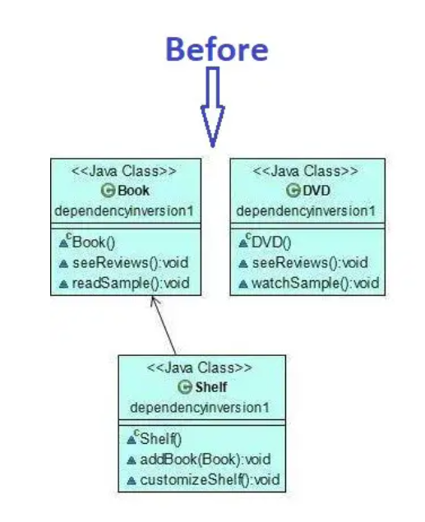
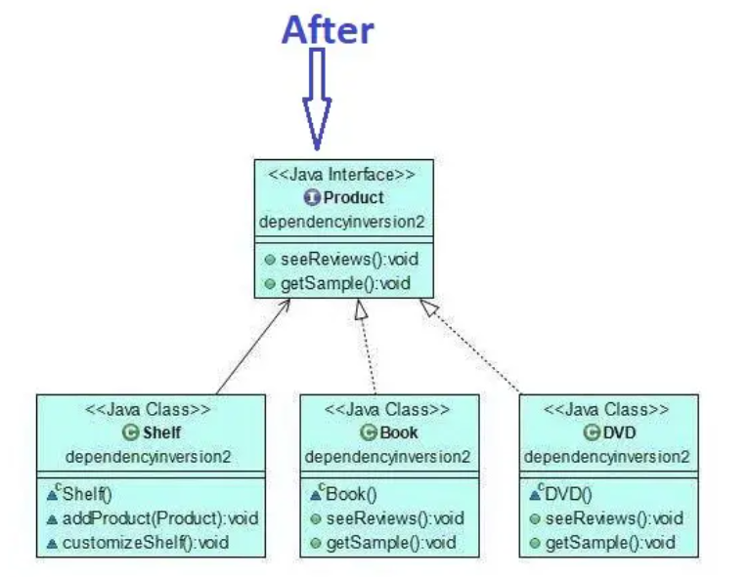
Example

Slide 50
References
Clean Architecture: A Craftsman's Guide to Software Structure and Design, 1st Edition, Robert C. Martin, Pearson, 2017.

